Slide 1
進度報告
Department of Electrical Engineering, National Yunlin University of Science and Technology
E-mail: M11312107@yuntech.edu.tw
Professor : 洪崇文 博士
Student : 李崎維
Date : 12/16/2025
Notes:
1

Slide 2

當前進度
做ICAROB報告PPT(稿還要修到12分鐘)
測試MCU
測試新震盪子
遭遇問題

Slide 3
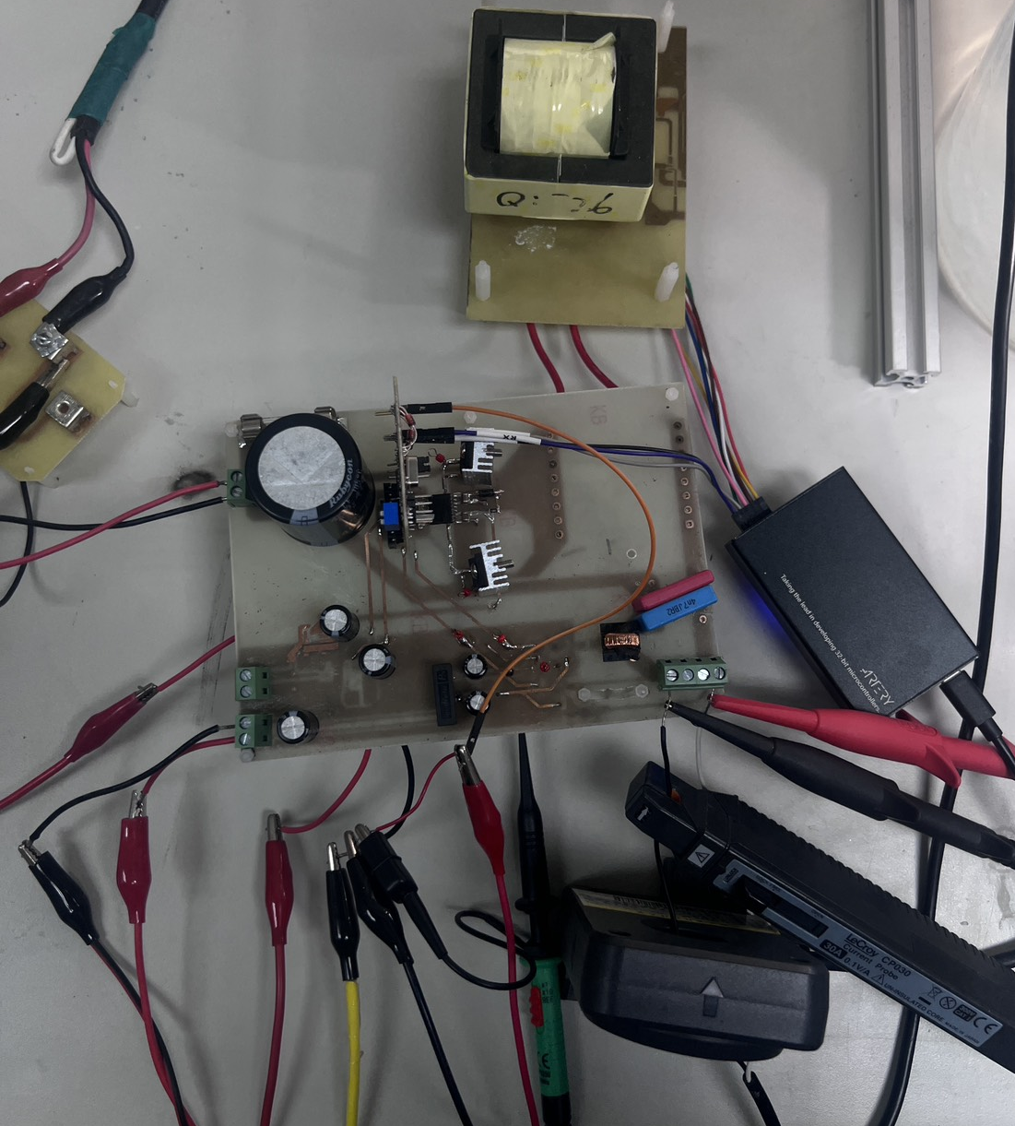
測試MCU
測試
捕捉決定大週期的PWM
打決定大週期的PWM

Slide 4
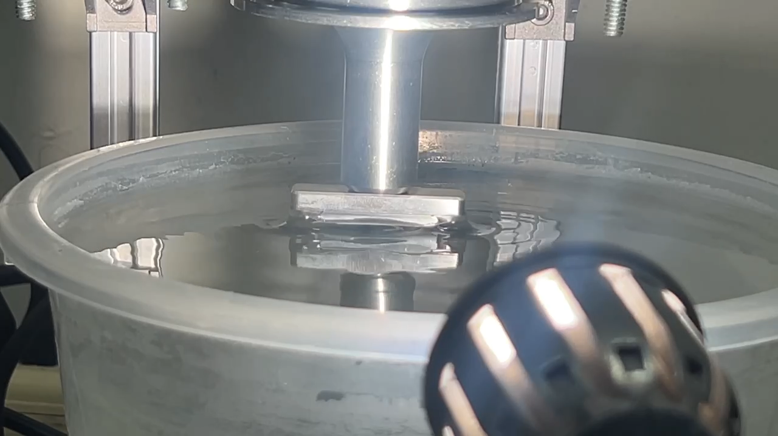
測試MCU
測試 1HZ 5HZ 10HZ 30HZ 50HZ 100HZ

Slide 5
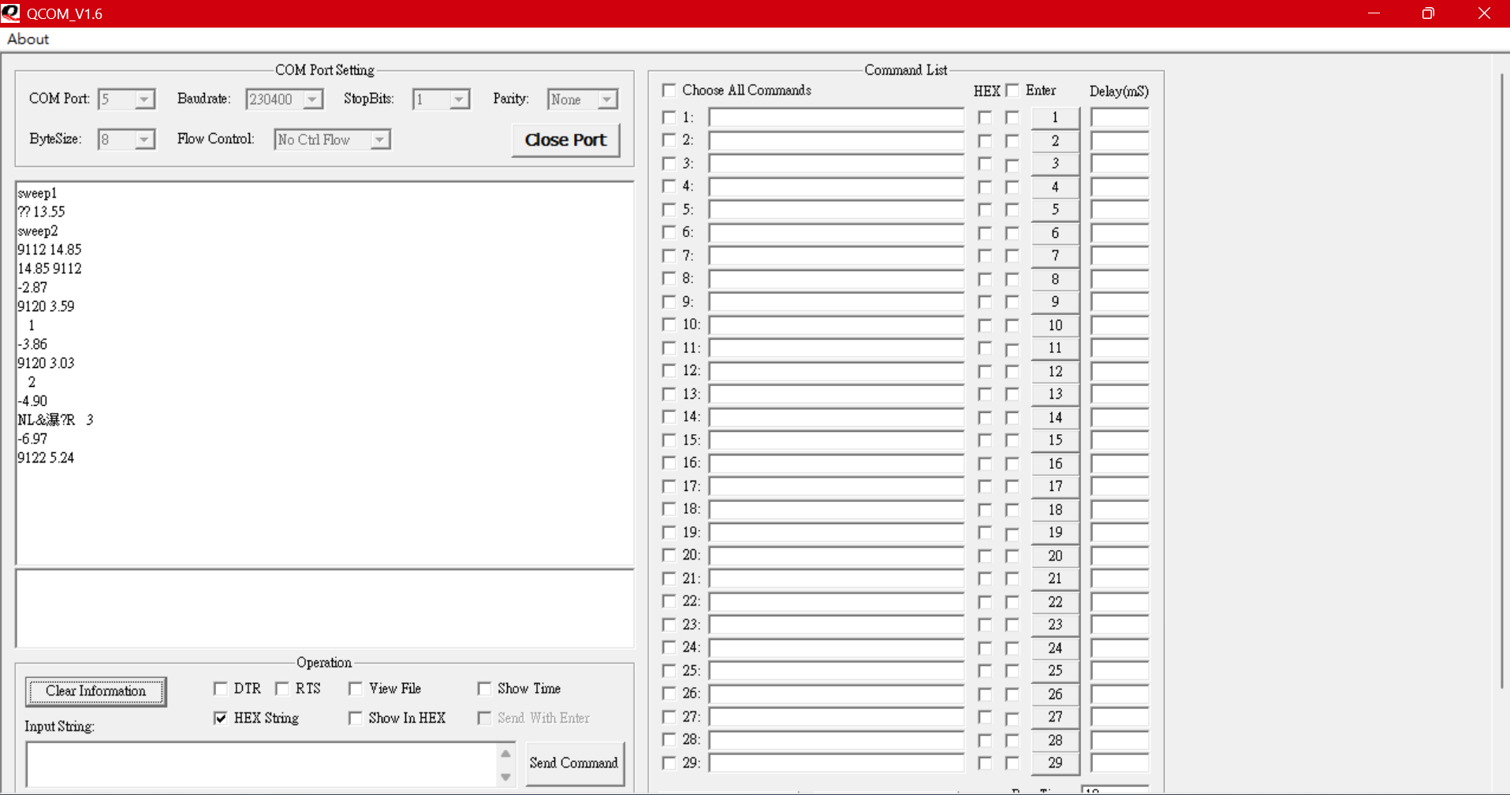
測試MCU
測試加入載波 功率計算出負值 誤調頻

Slide 6
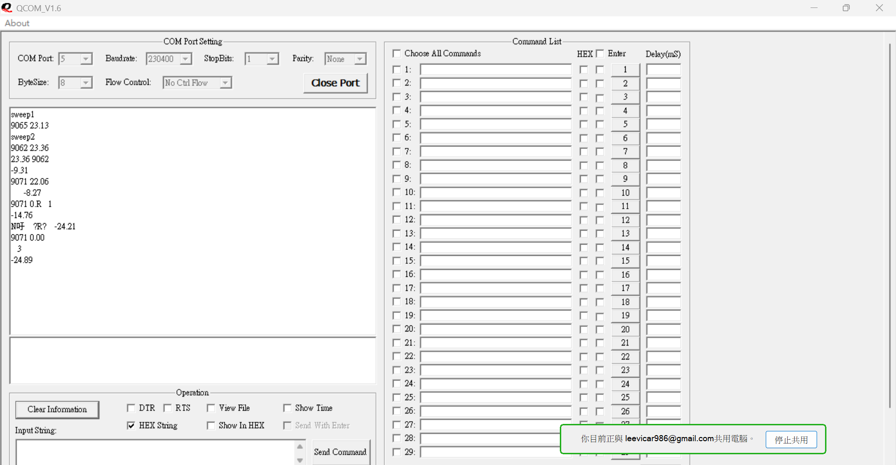
測試MCU
測試 加入載波 功率計算出負值 誤調頻

Slide 7
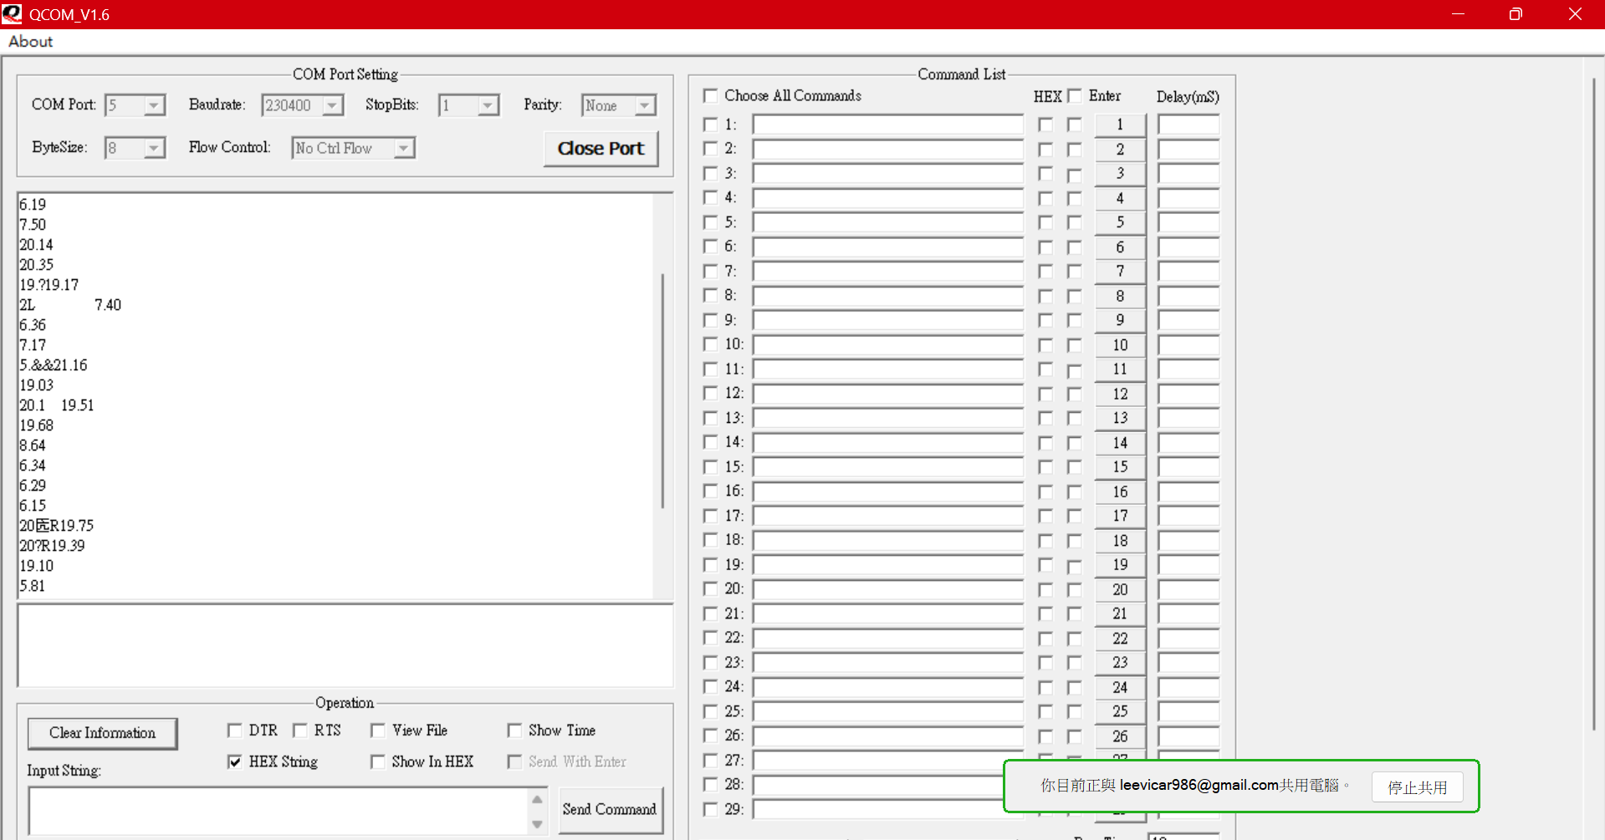
測試MCU
測試 加入載波 功率計算有誤 測試不同載波頻率1HZ
(之前卡DELAY，舉FLAG的方式沒用)

Slide 8
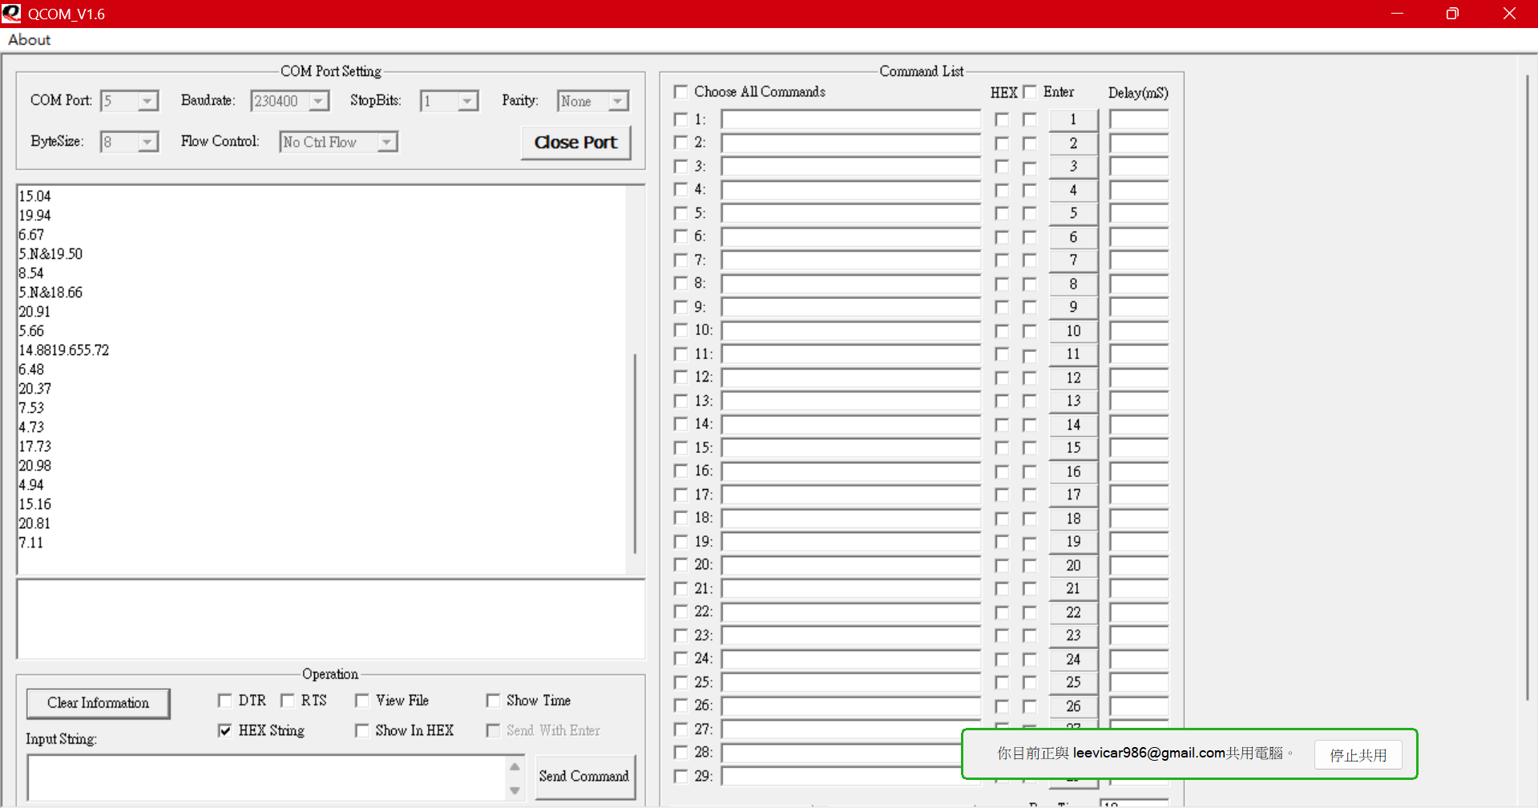
測試MCU
測試 加入載波 功率計算有誤 測試不同載波頻率100HZ

Slide 9
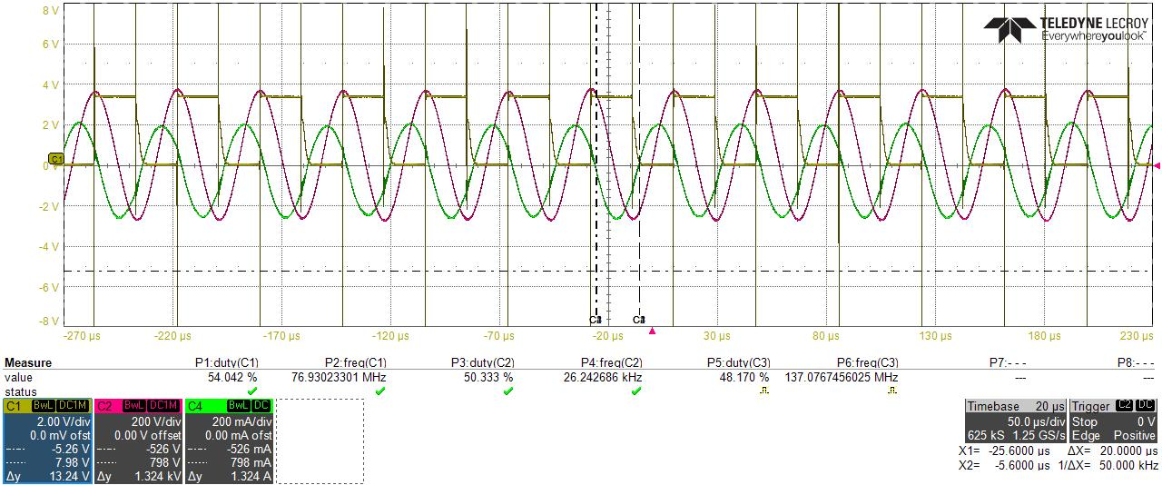
測試MCU
確認PWM是否會受震盪子干擾

Slide 10
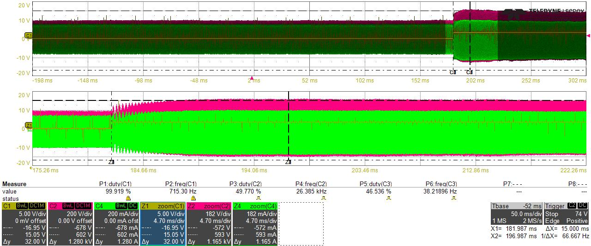
測試MCU
確認電壓電流是否照預期

Slide 11
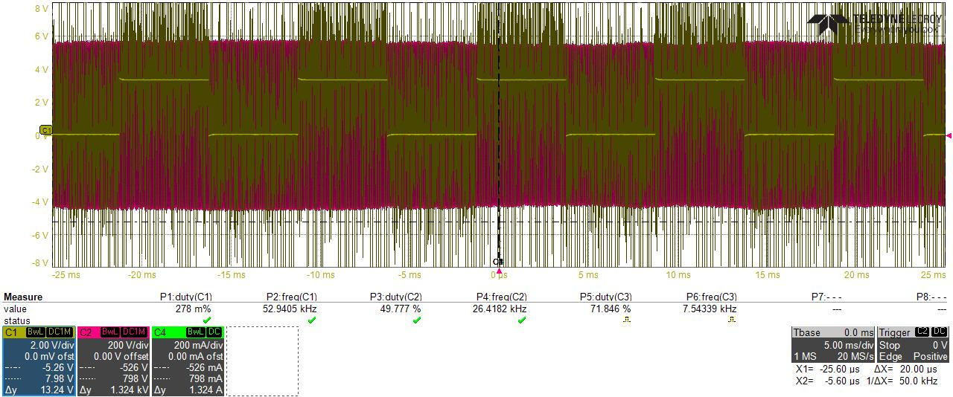
測試MCU
不確定是否是因為干擾(之前測試過應該不會)

Slide 12
預計進度
功率計算修正
整合之前全部的CODE
ICAROB寫稿被稿
改一板學長期刊

Slide 13
Modulation Control Strategies
for Ultrasonic Transducers
Chi-Wei Li, Chung-Wen Hung
National Yunlin University of Science and Technology, Taiwan
Notes:
Good morning everyone. My name is Chi-Wei Li from National Yunlin University of Science and Technology, Taiwan.
Today, I will present our work entitled “Modulation Control Strategies for Ultrasonic Transducers,” focusing on intermittent operation under automatic frequency tracking.
This work was conducted by Chung-Wen Hung and myself

Slide 14
1
Introduction
2
System Architecture
Outline
3
Result
4
Conclusion
Notes:
The following is my outline
First I’m going to introduce the topic.
Next the load and system architecture will be represented.
Third, is result and Discussion.
Finally, I’ll give the conclusion.

Slide 15

01
PART ONE
Introduction

Slide 16
01
Introduction
YunTech
Ultrasound refers which frequency or vibration is over 20 kHz .
Ultrasonic applications are widely used :
  Medical field: Ultrasonic scalpels
  Industrial field: Ultrasonic cleaning machines
In liquid atomization systems, output power modulation is required
to control droplet size and distribution.
PWM modulation strategies can significantly affect power stability and atomization performance.
1
Notes:
Ultrasound originated in the 19th century and its frequency exceedes 20 kHz.
Currently , many products use Ultrasonic, with the most common applications of ultrasound include in the medical field
, such as ultrasonic scalpels, and in the industrial field, such as ultrasonic cleaning machines.
In atomization systems, output power modulation is required to control droplet size and distribution.
However, when intermittent operation is required, different PWM modulation strategies may significantly affect power stability and atomization performance.
超音波起源於十九世紀，其頻率高於 20 kHz。
目前已有許多產品使用超音波，最常見的應用包括醫療領域中的超音波刀，以及工業領域中的超音波清洗設備。
其中在液體霧化中，系統必須能夠調變輸出功率，以控制液滴大小與分佈。
然而，當系統同時需要週期性的間歇輸出時，加入 PWM 調變後，不同調變方式會對功率穩定度與霧化效果造成顯著影響。

Slide 17
02
System Architecture
YunTech
Compare three modulation methods:
Ramp-Up / Ramp-Down
Trapezoidal modulation
Fixed-duty alternating switching
Evaluate effects on:
Power stability
Transient response
Compatibility with frequency tracking
Identify the most suitable strategy for intermittent operation
4
Notes:
Based on this motivation, the objective of this study
is to investigate PWM modulation strategies
for intermittent ultrasonic atomization.
In this work, we compare three commonly used modulation methods:
ramp-up and ramp-down modulation,
trapezoidal modulation,
and fixed-duty alternating switching.
These methods are evaluated in terms of power stability,
transient response behavior,
and their compatibility with automatic frequency tracking.
The goal is to identify a modulation strategy
that can provide clear intermittent output
while maintaining stable power and reliable frequency tracking.
基於前述研究動機，
本研究的目標是探討適用於間歇式超音波霧化的 PWM 調變策略。
本研究比較三種常見的調變方式，
分別是 Ramp-Up / Ramp-Down、
梯形波調變，以及固定 duty 交替切換。
評估重點包含功率穩定性、
暫態響應行為，
以及與自動頻率追蹤機制的相容性。
最終目標是找出一種
能夠同時提供清楚間歇輸出、
並維持穩定運作的最佳調變策略。

Slide 18
02
PART TWO
System Architecture

Slide 19
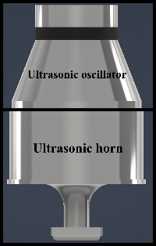
02
Load
YunTech
Oscillator specifications
  50W, 28kHz bolt-clamped Langevin transducer(BLT).
Adding horn Increase vibration
An ultrasonic oscillator is a type of piezoelectric component that is prone to frequency drift due to the following factors:
  Mechanical structure
  Component aging
  Temperature
  Resonance matching
3
Notes:
As shown in this image, the load I am using is a Power fifty Watt, frequency twenty-eight kilohertz oscillator bolt-clamped Langevin transducer.
To focus the vibration at a single point and amplify it, a horn cap was added.
After adding the horn cap, the overall mechanical structure has a significant impact on the optimal resonant frequency.
In practical operation, piezoelectric transducers suffer from resonance frequency drift due to thermal effects, aging, and load variation. Therefore, automatic frequency tracking is commonly required.
如圖所示，我使用的負載是功率五十瓦頻率、二十八千赫振盪器螺栓夾的朗之萬換能器。
為了將振動集中在單一點並放大，並加裝了喇叭帽
加上號角帽後，共振頻率為27.06千赫茲
整體機械結構對最佳共振頻率有顯著影響。
在實際操作中，壓電換能器因熱效應、老化及負載變化而產生共振頻率漂移。因此，通常需要自動頻率追蹤。

Slide 20
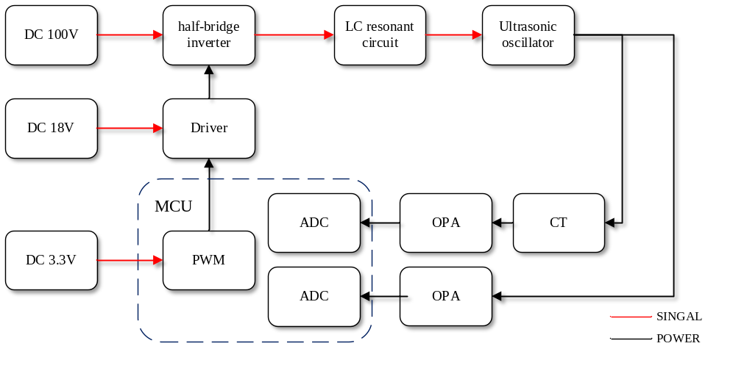
02
System Architecture
YunTech
Hardware architecture
  Main circuit section
  A half-bridge inverter with LC resonance, producing a high-frequency AC wave
Auxiliary power section
    18V for Gate drive
    3.3V for MCU
Current measurement is conducted using current transformers
Voltage and current feedback are used for real-time power calculation and automatic frequency tracking
4
Notes:
As shown in this figure, this slide illustrates the hardware architecture of the proposed system.
The main power stage uses an adjustable DC power supply as the input.
A half-bridge inverter, combined with an LC resonant circuit, filters out high-order harmonics and generates a high-frequency sinusoidal voltage to drive the ultrasonic transducer.
Auxiliary power supplies of 18 volts and 3.3 volts are used to power the gate driver and the microcontroller unit, respectively.
A current transformer and an operational amplifier are employed for current and voltage sensing,
while voltage and current feedback signals are used for real-time power calculation and automatic frequency tracking.
如圖所示，這張投影片展示了所提系統的硬體架構。 主電源級使用可調直流電源作為輸入。
半橋逆變器結合液晶諧振電路，能濾除高階諧波，並產生高頻正弦波電壓以驅動超音波換能器。 輔助電源分別為18伏特和3.3伏特供電給閘極驅動器和微控制器單元。 電流與電壓感測器會使用電流互感器和運算放大器，
而電壓與電流反饋訊號則用於即時功率計算及自動頻率追蹤

Slide 21
03
PART THREE
Results and Discussion

Slide 22
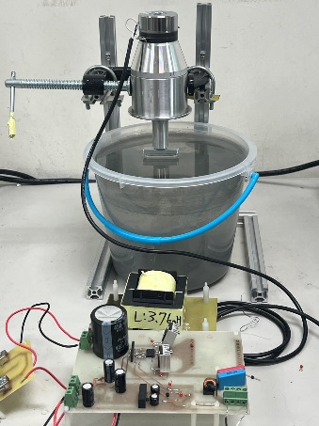
02
System Architecture
YunTech
Ultrasonic atomization system
Bolt-clamped Langevin transducer with horn
Water load for atomization
Laboratory-developed driver and control circuit
4
Notes:
This slide shows the experimental setup used in this study.
The system consists of a bolt-clamped Langevin ultrasonic transducer with a horn,
which is driven by a custom-built power driver and control circuit.
The transducer operates under a water load to evaluate atomization behavior
and system performance under different PWM modulation strategies.
All experiments were conducted under identical electrical and mechanical conditions to ensure fair comparison.
這張圖是本研究使用的實驗平台。
上方為加裝變幅桿的螺栓式 Langevin 超音波震盪子，
下方為自行設計的驅動與控制電路。
震盪子在水負載條件下進行霧化實驗，用來評估不同 PWM 調變策略下的系統表現。

Slide 23
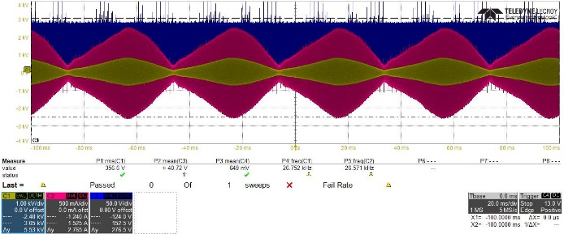
03
Result
YunTech
Duty cycle gradually increases and decreases
Smooth power transition within one modulation cycle
Avoids sudden power changes
Limitations for intermittent operation:
  Unclear instantaneous power boundaries
  Incompatible with frequency tracking
  Irregular atomization performance
Output voltage
under Ramp-Up/Ramp-Down modulation
6
Notes:
The first method is ramp-up and ramp-down modulation, which is commonly used in PWM power control.
In this approach, the PWM duty cycle gradually increases or decreases within one modulation cycle
to smoothly adjust the output energy.
Although this method avoids sudden power changes, it is not suitable for intermittent operation,
because the instantaneous power boundaries are unclear.
In addition, it shows poor compatibility with automatic frequency tracking
and leads to irregular atomization performance.
第一種方法是 Ramp-Up/Ramp-Down 調變，在 PWM 控制中相當常見。
此方法透過在一個調變週期內，逐漸增加或減少 duty cycle，來平順地調整輸出能量。雖然可避免功率突變，
但在間歇輸出時，功率界線不清楚，
且不利於自動頻率追蹤，也容易造成霧化不穩定。

Slide 24
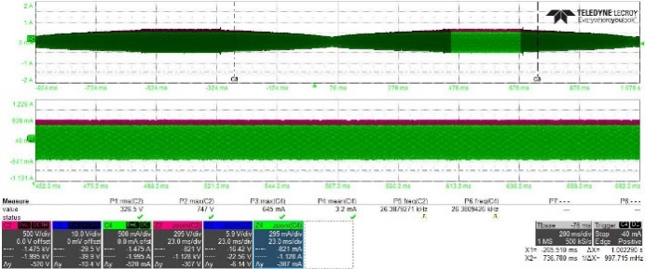
03
Result
YunTech
Duty cycle increases from 10% to 50% in steps
High-duty region allows power stabilization
Compatible with automatic frequency tracking
Limitations:
  Long rise and fall times
  Limited modulation frequency
  Higher input voltage required for higher frequency
6
Notes:
To address the limitations of ramp-up and ramp-down modulation, the second method adopts trapezoidal,
or pseudo-sinusoidal, modulation.
In this method, the duty cycle increases from 10% to 50% in steps and remains briefly at the high-duty level,
allowing the output power to rise and stabilize.
This approach is compatible with automatic frequency tracking and enables stable measurement of maximum power.
However, due to the long rise and fall times, the achievable modulation frequency is limited.
To further increase the modulation frequency, a higher input voltage is required.
第二種方法為梯形波，或稱類正弦波調變。
此方法將 duty cycle由 10% 逐步增加至 50%，
並在高 duty 區間短暫停留，使輸出功率能夠穩定達到最大值。
該方法可與自動頻率追蹤相容，也有利於最大功率的穩定量測。
然而，由於上升與下降時間較長，可達的調變頻率受到限制，若需更高頻率，必須提高輸入電壓。

Slide 25
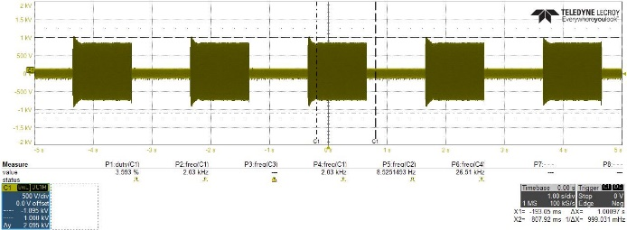
03
Result
YunTech
Duty cycle directly switches between 10% and 50%
Shorter rise and fall times
Enables higher modulation frequency
Compatible with automatic frequency tracking
Produces clear on–off atomization effect
Selected for subsequent experiments
6
Notes:
The third method is fixed-duty alternating switching, where the duty cycle directly switches between 10% and 50%.
Experimental results show that although the transducer output still rises and falls gradually,
the rise and fall times are significantly shorter than those of the previous two methods.
This enables higher modulation frequencies while maintaining compatibility
with automatic frequency tracking.
In addition, the resulting on–off atomization effect is more distinct.
Therefore, based on the experimental comparison, this method is adopted for subsequent tests.
第三種方法為固定 duty 交替切換，直接在 10% 與 50% 之間切換。
實驗結果顯示，雖然震盪子的輸出仍具有暫態行為，
但其上升與下降時間明顯短於前兩種方法。
此方法可支援較高的調變頻率，並且與自動頻率追蹤機制相容。
同時，其 on-off 霧化效果也更加明確，因此後續實驗皆採用此調變方式。

Slide 26
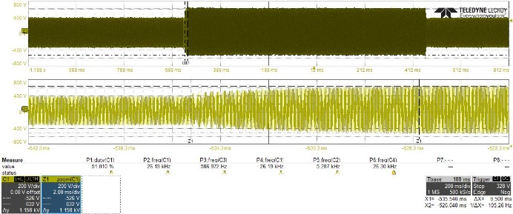
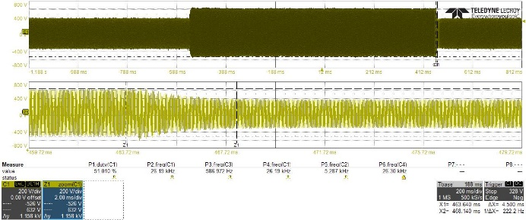
03
Experimental Setup
YunTech
Power calculation must correspond to maximum
power point
Rise time from 10% to 50% duty at 100 V
Fall time back to 10% duty is approximately
7.75 ms
Atomization ceases at around 30% duty
Minimum duty set to 30% to shorten transient
time
Notes:
Because automatic frequency tracking is applied, it is necessary to ensure that the calculated power corresponds to the actual maximum power point
at the current input voltage. Figure shows the rise time
from 10% to 50% duty cycle at 100 volts, while Figure indicates that
the fall time back to 10% duty is approximately 7.75 milliseconds.
In this application, atomization already stops at around 30% duty.
Therefore, by setting the minimum duty to 30%, the rise time to the high-power region
and the fall time to the low-level steady state can both be significantly reduced
由於本系統採用自動頻率追蹤機制， 因此必須確認所計算的功率 能夠對應到當下輸入電壓的最大功率點。
圖顯示在 100 V 輸入下，duty cycle 由 10% 上升至 50%
所需的時間， 而圖七顯示下降回 10% 約需 7.75 毫秒。
實際上，霧化效果在約 30% duty即已停止， 因此不需要回落至 10%。
透過將最低 duty 設為 30%，可有效縮短進入高功率區與回到低功率穩態的暫態時間

Slide 27
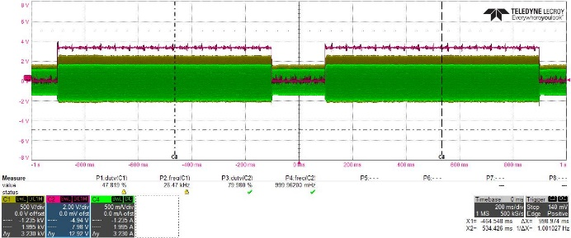
03
Experimental Setup
YunTech
Average steady-state time ≈ 15 ms at 100 V
Ramp and trapezoidal modulation:
  Max frequency ≈ 50 Hz
  Weak atomization
Fixed-duty alternating switching:
  Visible atomization at 50 Hz
  Stable operation up to 100 Hz
Better compatibility with frequency tracking
Notes:
At an input voltage of 100 volts, the average steady-state time
of the transducer is approximately 15 milliseconds.
When ramp-type or trapezoidal modulation is applied, the maximum switching frequency
is limited to around 50 hertz, and only weak atomization is observed.
In contrast, fixed-duty alternating switching produces visible atomization at 50 hertz
and maintains stable atomization even at 100 hertz under the same input voltage.
This method also shows better compatibility with automatic frequency tracking,
because the longer high-level steady state enables more accurate power calculation.
Long-duration experiments further confirm its reliability.
在 100 V 輸入條件下，震盪子達到穩態約需 15 毫秒。
當採用 Ramp 或梯形波調變時，最大切換頻率約限制在 50 Hz，
且霧化效果較為微弱。相較之下，固定 duty 交替切換
在相同輸入電壓下，不僅在 50 Hz 能產生明顯霧化，
在 100 Hz 仍可維持穩定輸出。此外，由於高功率穩態時間較長，更有利於自動頻率追蹤進行準確的功率計算。
長時間實驗也進一步驗證此方法的可靠性。

Slide 28
04
PART FIVE
Conclusion

Slide 29
05
Conclusion
YunTech
Intermittent PWM affects frequency tracking
Fixed-duty alyernating switching
Variable-duty PWM improves performance
At present, the system still can maintain long-term frequency tracking
  temperature fluctuations
  mechanical structure
  The initial LC matching no longer being suitable for the altered frequency
Future research will focus on addressing these potential issues.
10
Notes:
In conclusion, intermittent operation has a significant impact on both power stability and automatic frequency tracking in ultrasonic transducer systems.
for ultrasonic atomization systems that require intermittent operation,
fixed-duty alternating switching is the most suitable PWM modulation strategy.
It provides clear power boundaries, fast transient response, and good compatibility with automatic frequency tracking.
總結而言，間歇式操作會明顯影響超音波震盪子系統的功率穩定度與自動頻率追蹤表現。
對於需要間歇輸出的超音波霧化系統，
固定 duty 交替切換能提供清楚的功率界線、快速的暫態反應，
並且與自動頻率追蹤機制具有最佳相容性，
因此是最適合的 PWM 調變策略。
這些結果顯示，在超音波霧化系統中，調變策略與追頻演算法必須一併設計。

Slide 30
THANK YOU
Notes:
My report concludes here
Thank for your Listen

